Slide 1

Machine Learning for Subsurface engineers
Dursun Dashdamirov, Nadir Zeynalli, Vugar Dunyamaliyev
Session III, 1 March 2026

Slide 2
Machine Learning for Subsurface engineers
This program is dedicated to applications of Machine Learning on various subsurface disciplines, including geology, geophysics, drilling, petroleum, and reservoir engineering.
Topics
Predictive Modeling with subsurface data
Supervised Learning (Regression)
3. Supervised Learning (Classification)
4. Unsupervised learning
5. Neural Networks
6. Generalization, Uncertainty Quantification, Explainability
7. Capstone Project
Format
Online, with hands-on math/programming exercises
6 lectures in 6 weeks + 1 lecture for presentations
15 February - 29 March (Sundays, 6-8 pm Baku time)

Slide 3
3. Supervised learning (Classification)
Nadir Zeynalli, Dursun Dashdamirov
3.1 classification
3.2 Logistic regression
3.3 decision trees

Slide 4
1. Supervised machine learning
This is a type of machine learning paradigm where an algorithm learns to map input data to a specific output based on example input-output pairs.
$$Y=f\left(x_{1},x_{2},x_{3}\right) + ε$$
Target
Response
Independent
Irreducible error
Caused by
1.
2.
Bonus:
Deterministic structure relating 𝑥 to 𝑦
Predictor
Input
Dependent
=
f(
)
k (mD) | Net Pay (ft) | Sw
12 | 18 | 55
35 | 25 | 48
120 | 42 | 32
250 | 55 | 28
8 | 15 | 60
Productivity (y)
0
1
2
2
0
Notes:
1. Measurement noise 2. Unobserved / missing variables 3. Intrinsic randomness (human behavior, turbulent flow regimes etc.)

Slide 5
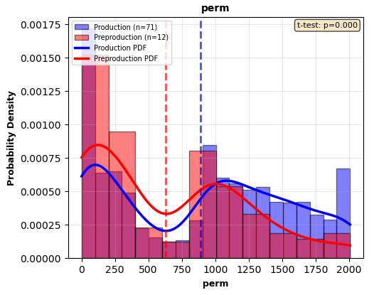
Assumptions of Supervised ML
The word “prediction” sounds magical. In reality, it rests on two fundamental statistical assumptions:
There is a probability distribution D over (x, y) pairs
The training and test data are random samples (x1, y1), . . . ,(xn, yn),(x, y) i.i.d. ∼ D
i.i.d = independent and identically distributed
Each (x,y) pair is randomly drawn from a population
=
f(
)
k (mD) | Net Pay (ft) | Sw
1200 | 2 | 89
1800 | 1 | 78
Productivity (y)
High
Low

Slide 6

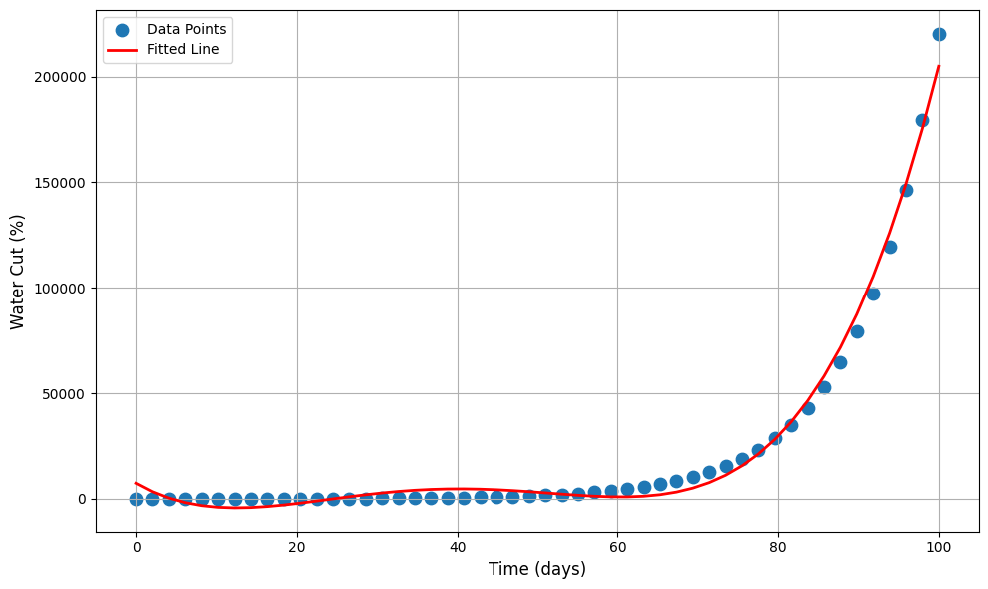
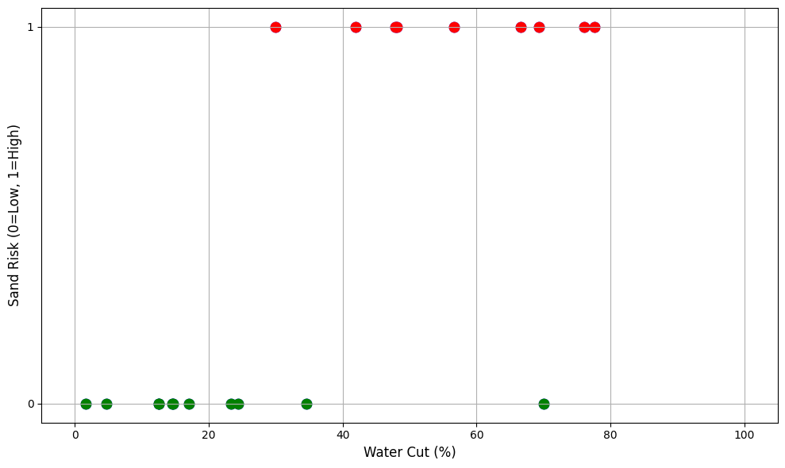
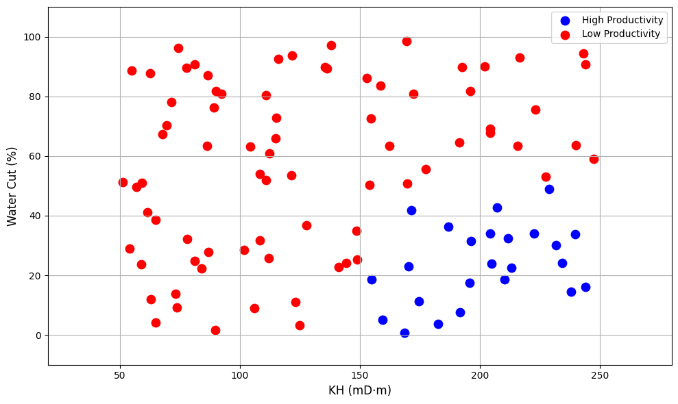
Classification
Q: Is there sand risk for this well?
A: Yes / No (High / Low)
Q: Is this well a good candidate for acidizing?
A: Suitable / Not Suitable
Q: Will this ESP fail within 6 months?
A: Fail / No Fail
Q: Is this interval productive?
A: Pay / Non-pay
 | Regression | Classification
Output | Continuous number | Category
Example | Predict reservoir pressure | Predict sand risk
Output Range | (-∞, +∞) | Limited set (0/1)

Slide 7
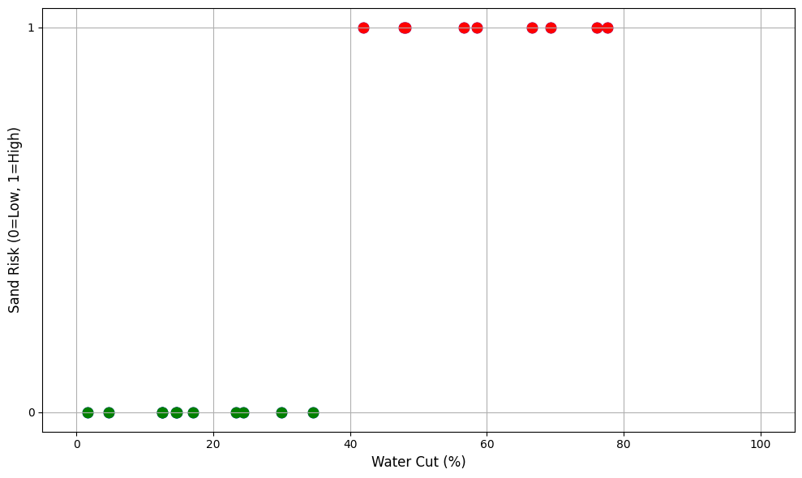
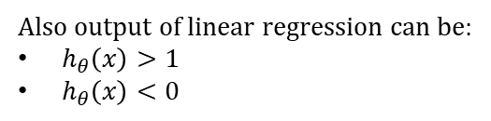
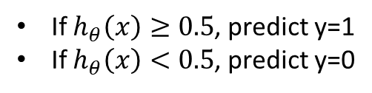


Classification
Binary classification
$$y∈\{0,1\}$$
0: “Negative Class” (e.g., no sand risk) 1: “Positive Class” (e.g., sand risk)
Water cut % | Sand risk
10 | No (0)
25 | No (0)
30 | No (0)
45 | Yes (1)
70 | Yes (1)
75 | Yes (1)
Linear regression
Multi-class classification
If $h_{θ}\left(x\right)≥0.5$, predict y=1
If $h_{θ}\left(x\right)<0.5$, predict y=0
$$h_{θ}\left(x\right)=θ^{T}x$$
$$y∈\{0,1,2,…,k\}$$
Rock type classification:
0: sandstone
1: limestone 2: shale
3: dolomite
Also output of linear regression can be:
$h_{θ}\left(x\right)>1$
$h_{θ}\left(x\right)<0$

Slide 8
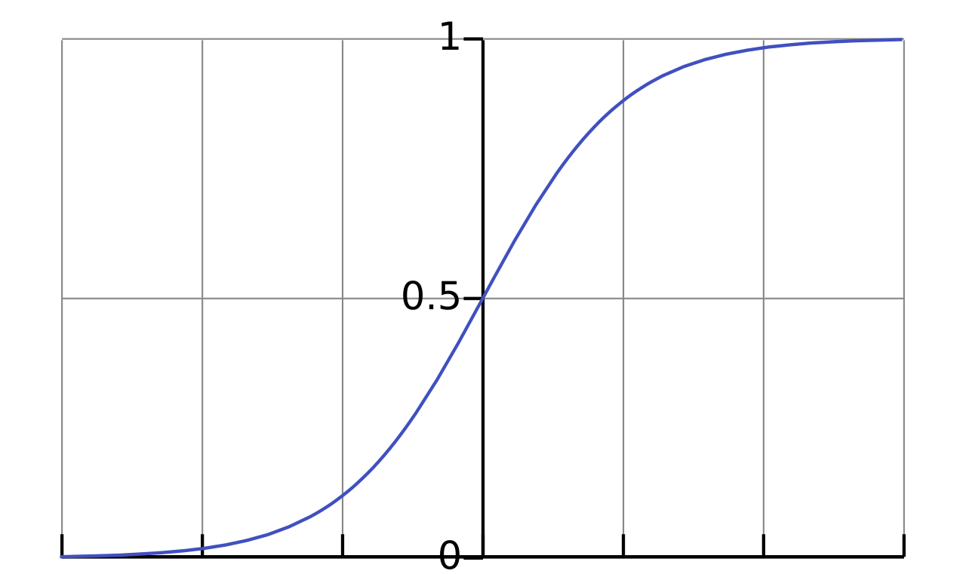
Hypothesis for logistic regression
g(z)
$$0≤h_{θ}\left(x\right)≤1$$
Linear regression
Logistic regression
$$h_{θ}\left(x\right)=θ^{T}x$$
$$h_{θ}\left(x\right)={g(θ}^{T}x)$$
Sigmoid / Logistic function:
$$g\left(z\right)=\frac{1}{1+e^{−z}}$$
$$h_{θ}\left(x\right)=\frac{1}{1+e^{−θ^{T}x}}$$
z
Interpretation of $h_{θ}\left(x\right)$
estimated probability of y=1, given x
If $h_{θ}\left(x\right)=0.8$ - there is 80% chance that the well has sand risk
$p\left(y=0 | x;θ\right)+p\left(y=1 | x;θ\right)=1$
$p\left(y=0 | x;θ\right)=1−p\left(y=1 | x;θ\right)$ $p\left(y=0 | x;θ\right)=1 −h_{θ}(x)$
0: there is no sand risk 1: there is sand risk
$h_{θ}\left(x\right)=p(y=1|x;θ)$

Slide 9
Decision boundary
g(z)
$$h_{θ}\left(x\right)={g(θ}^{T}x)$$
$$g\left(z\right)=\frac{1}{1+e^{−z}}$$
If $h_{θ}\left(x\right)≥0.5$, predict y=1
If $h_{θ}\left(x\right)<0.5$, predict y=0
z
$g\left(z\right)≥0.5$ when $z≥0$
$$θ^{T}x≥0$$

Slide 10
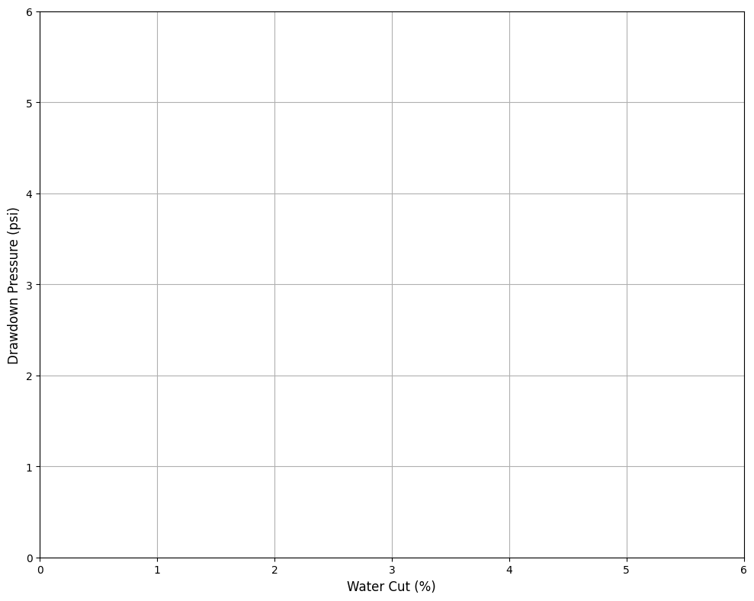

Decision boundary
$$h_{θ}\left(x\right)=g(θ_{0}+θ_{1}x_{1}+θ_{2}x_{2})$$
No sand risk
Sand risk
predict y=1 when $θ^{T}x≥0$
$−4+x_{1}+x_{2}≥0$
$x_{1}+x_{2}≥4$
Decision boundary is property of h(x)

Slide 11
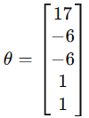
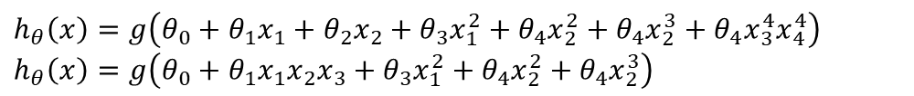
Decision boundary
$h_{θ}\left(x\right)=g\left(θ_{0}+θ_{1}x_{1}+θ_{2}x_{2}+θ_{3}x_{1}^{2}+θ_{4}x_{2}^{2}\right)$
${\left(x_{1}−3\right)}^{2}+{\left(x_{2}−3\right)}^{2}≥1$
$h_{θ}\left(x\right)=g\left(θ_{0}+θ_{1}x_{1}+θ_{2}x_{2}+θ_{3}x_{1}^{2}+θ_{4}x_{2}^{2}+θ_{4}x_{2}^{3}+θ_{4}x_{3}^{4}x_{4}^{4}\right)$
$h_{θ}\left(x\right)=g\left(θ_{0}+θ_{1}x_{1}x_{2}x_{3}+θ_{3}x_{1}^{2}+θ_{4}x_{2}^{2}+θ_{4}x_{2}^{3}\right)$

Slide 12
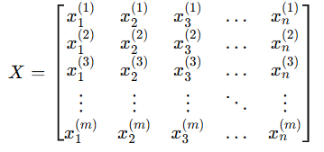
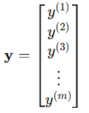






Cost function
Cost function for Linear regression:
$$h_{θ}\left(x\right)=\frac{1}{1+e^{−θ^{T}x}}$$
Non linear
$$y∈\{0,1\}$$
Non-convex
Convex
$$J(θ)$$
$$J(θ)$$
$$θ$$
$$θ$$

Slide 13


Cost function
Cost function for Logistic regression:
If y=1
If y=0
Cost
Cost
$$h_{θ}\left(x\right)$$
1
$$h_{θ}\left(x\right)$$
1
IF y=1 and $h_{θ}\left(x\right)=1$ THEN $Cost=0$
IF y=1 and $h_{θ}\left(x\right)=0$ THEN $Cost → ∞$
IF y=0 and $h_{θ}\left(x\right)=0$ THEN $Cost=0$
IF y=0 and $h_{θ}\left(x\right)=1$ THEN $Cost → ∞$
Logistic loss

Slide 14



Other loss functions
Logistic loss
0-1 loss
Cross-entropy loss
Hinge loss
Smooth
Convex
Differentiable
Penalizes confident wrong predictions heavily
Correct classification – 0
Wrong classification – 1
Downsides:
Non-differentiable
Discontinuous
Impossible for gradient descent
“No probability”
Same as logistic loss for binary classification
Used in:
Softmax regression
Neural networks
Deep learning
If classification is correct and confident -> loss = 0
If inside margin -> penalized
If wrong -> penalized linearly
Used in SVM
Hinge loss cares about margin
Logistic loss cares about probability

Slide 15




Gradient descent
Cost function for
linear regression:
We want to minimize $J(θ)$
P.S. Derivation in backup
$$h_{θ}\left(x\right)=\frac{1}{1+e^{−θ^{T}x}}$$
$$h_{θ}\left(x\right)=θ^{T}x$$
Linear regression
Logistic regression
Other optimization algorithms
Gradient descent
Conjugate gradient
BFGS
L-BFGS
Plot cost function as a function of the number of iterations and make sure cost function $J\left(θ\right)$ is decreasing on every iteration
FEATURE SCALING IS ALSO VERY IMPORTANT FOR LOGISTIC REGRESSION

Slide 16
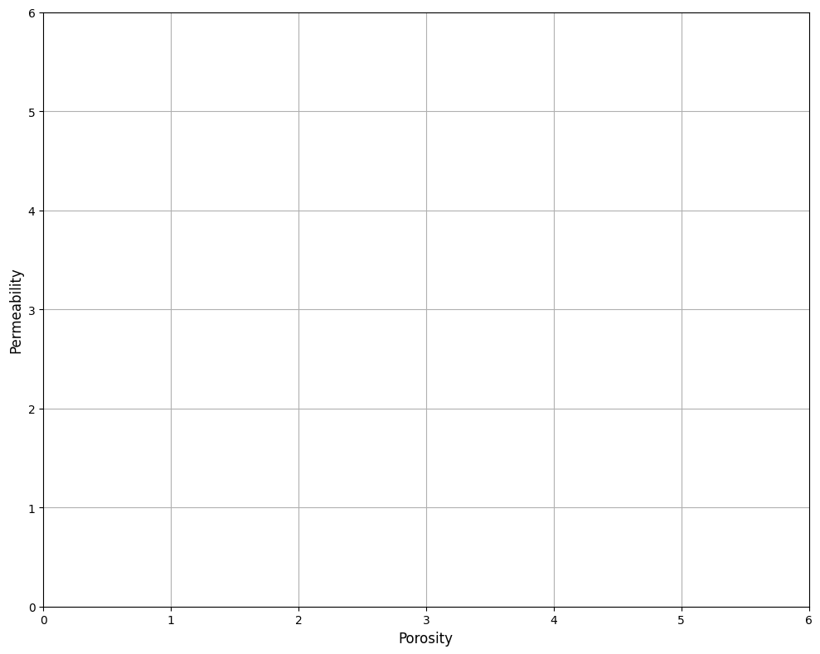
Multi-class classification
Binary
Multi-class
Rock type classification
Sandstone – pay
Limestone – pay
Shale – non pay
Shale
Non pay
Sandstone
Pay
Limestone
“One vs all” method
Train a logistic regression classifier $h_{θ}^{\left(i\right)}(x)$ for each class i to predict probability that y=I
On a new input x, run all the classifiers and pick the class i which maximizes $h_{θ}^{\left(i\right)}(x)$

Slide 17




Accuracy metrics
Accuracy – overall correctness
Precision – When we predict Pay, how often are we correct?
Recall – How many real Pay zones did we detect?
F1 – Balance between Precision and Recall
 | Predicted Pay (1) | Predicted Non-Pay (0)
Actual Pay (1) | TP | FN
Actual Non-Pay (0) | FP | TN
True Positive: Correctly predicted pay
False Positive: Wrongly predicted pay
False Negative: Missed pay zone
True Negative: Correctly predicted non-pay
Question: Which model is performing better?
Example Dataset:
Total intervals: 1000
Actual Pay zones: 50
Actual Non-Pay zones: 950
Model 1
Model 2
 | Predicted Pay (1) | Predicted Non-Pay (0)
Actual Pay (1) | 0 | 50
Actual Non-Pay (0) | 0 | 950
 | Predicted Pay (1) | Predicted Non-Pay (0)
Actual Pay (1) | 35 | 15
Actual Non-Pay (0) | 100 | 850
Metric | Focus | When to Use
Accuracy | Overall correctness | Balanced dataset
Recall | Minimize FN | Missing pay is costly
Precision | Minimize FP | Wrong completion costly
F1 | Balance | Both errors matter
Calculate Accuracy, Precision and Recall for these two models and comment on metrics

Slide 18
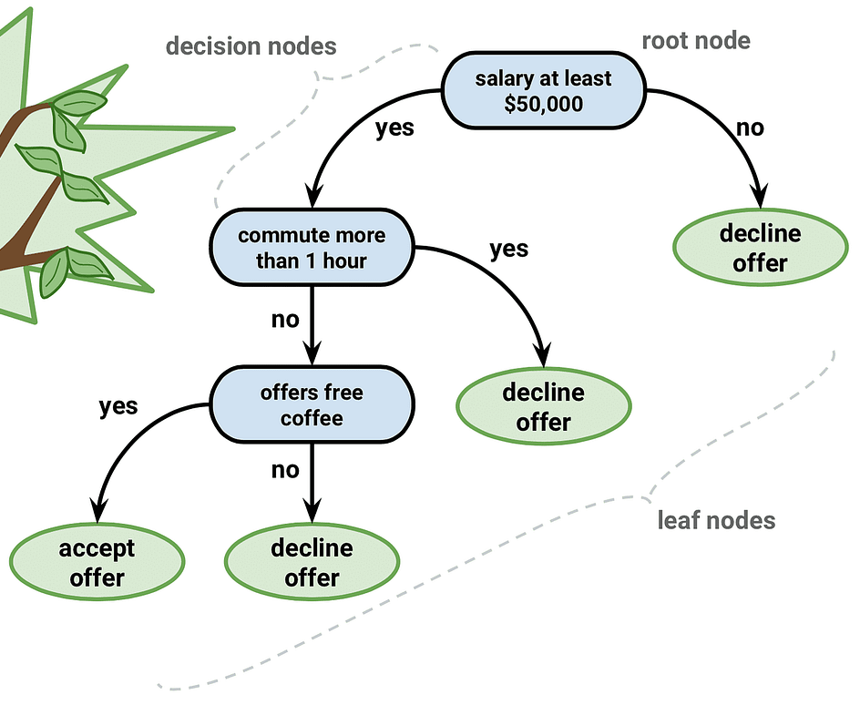
Decision trees
The goal is to create a model that predicts the value of a target variable by learning simple decision rules inferred from the features.
Why it's worth to learn decision trees:
Relatively easy to understand and interpret
They are non-parametric models
Their extensions still achieve cutting edge accuracy in tabular data with Bagging, Boosting
Extensive set of applications in subsurface tasks, with improvements on spatial understanding
Will applicant accept the offer?
Y = [no; yes]
Notes:
https://miro.medium.com/v2/resize:fit:1400/1*V1_3qLxRiqFPciJkP3LYcA.png
https://scikit-learn.org/stable/modules/tree.html

Slide 19
Making prediction with trees
Training data
Construct tree with lowest impurity
(highest similarity in leaf nodes)
Root node
Wait Time (min) | Appointment | Liked Service?
5 | In-person | Yes
10 | In-person | Yes
15 | Online | No
40 | In-person | No
20 | In-person | Yes
12 | Online | No
60 | Online | No
Wait time: < 30
Nodes
Yes
No
Appointment: In person?
Dislike
Leaves
Yes
No
Liked
Wait time: < 13.5
Testing data
Yes
No
13 | In-person | ?
60 | Online | ?
Dislike
Liked

Slide 20
Construction of trees
We need to make 2 decisions to achieve best separation:
Order of features
Where to put decision boundary (split)
Wait Time (min) | Appointment | Liked Service?
5 | In-person | Yes
10 | In-person | Yes
15 | Online | Yes
40 | In-person | No
20 | In-person | Yes
12 | Online | No
60 | Online | No
Let’s see how we decide on ordering!

Slide 21

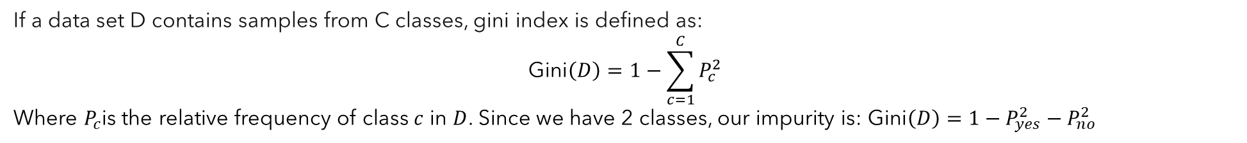

Construction of trees (order)
If a data set D contains samples from C classes, gini index is defined as:
$$\text{Gini}\left(D\right)=1−\sum_{c=1}^{C}{P_{c}^{2}}$$
Where $P_{c}$is the relative frequency of class $c$ in $D$. Since we have 2 classes, our impurity is: $\text{Gini}\left(D\right)=1−P_{yes}^{2}−P_{no}^{2}$
Wait Time (min) | Appointment | Liked Service?
5 | In-person | Yes
10 | In-person | Yes
15 | Online | Yes
40 | In-person | No
20 | In-person | Yes
12 | Online | No
60 | Online | No
Appointment: In person?
7 samples, 4Y 3N
True
False
3Y 1N
1Y 2N
$$Gini\left(Inperson\right)=1−{\left(\frac{1}{4}\right)}^{2}−{\left(\frac{3}{4}\right)}^{2}=1−0.625=0.375$$
$$Gini\left(Online\right)=1−{\left(\frac{1}{3}\right)}^{2}−{\left(\frac{2}{3}\right)}^{2}=1−0.555=0.445$$
Resulting impurity of split is
just weighted average:
$$Gini_{appointment}=\frac{n_{Inperson}}{N_{total}} Gini\left(Inperson\right)+\frac{n_{online}}{N_{total}}Gini\left(Online\right)=\frac{4}{7}×0.375+\frac{3}{7}×0.445=0. 405$$

Slide 22


Construction of trees (order)
If a data set D contains samples from C classes, gini index is defined as:
$$\text{Gini}\left(D\right)=1−\sum_{c=1}^{C}{P_{c}^{2}}$$
Where $P_{c}$is the relative frequency of class $c$ in $D$. Since we have 2 classes, our impurity is: $\text{Gini}\left(D\right)=1−P_{yes}^{2}−P_{no}^{2}$
Wait Time (min) | Appointment | Liked Service?
5 | In-person | Yes
10 | In-person | Yes
15 | Online | Yes
40 | In-person | No
20 | In-person | Yes
12 | Online | No
60 | Online | No
Wait time: < 30
7 samples, 4Y 3N
True
False
4Y 1N
0Y 2N
$$Gini\left(wait<30\right)=1−{\left(\frac{1}{5}\right)}^{2}−{\left(\frac{4}{5}\right)}^{2}=1−0.68=0.32$$
$$Gini\left(wait>30\right)=1−{\left(\frac{0}{2}\right)}^{2}−{\left(\frac{2}{2}\right)}^{2}=1−1=0$$
Resulting impurity of split is
just weighted average:
$$Gini_{wait_time}=\frac{n_{wait<30}}{N_{total}} Gini\left(wait<30\right)+\frac{n_{wait>30}}{N_{total}}Gini\left(wait>30\right)=\frac{5}{7}×0.32+\frac{2}{7}×0=0.229$$

Slide 23
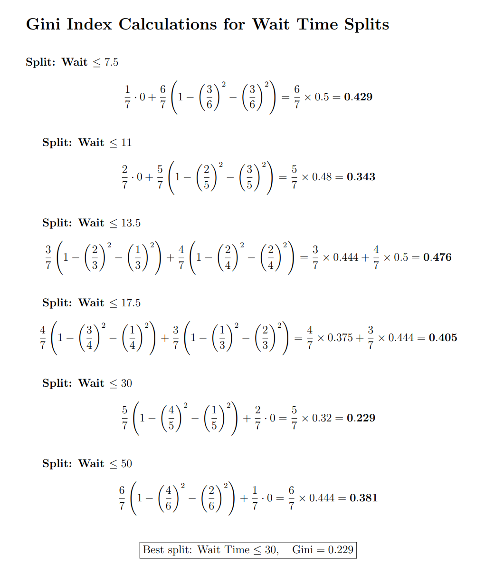

Construction of trees (split)
Wait Time (min) | Liked Service?
5 | Yes
10 | Yes
15 | Yes
40 | No
20 | Yes
12 | No
60 | No
1. Sort the dataset
Step 2. Calculate midpoints
Wait Time (min) | Liked Service?
5 | Yes
10 | Yes
12 | No
15 | Yes
20 | Yes
40 | No
60 | No
Step 3.
Calculate gini index
for possible splits

Slide 24


Construction of trees (order)
Wait time: < 30
7 samples, 4Y 3N
True
False
Appointment: In person?
5 samples, 4Y 1N
0Y 2N
Wait Time (min) | Appointment | Liked Service?
5 | In-person | Yes
10 | In-person | Yes
15 | Online | Yes
40 | In-person | No
20 | In-person | Yes
12 | Online | No
60 | Online | No
True
False
3Y 0N
1Y 1N
$$Gini\left(Inperson\right)=1−{\left(\frac{3}{3}\right)}^{2}−{\left(\frac{0}{3}\right)}^{2}=1−1=0$$
$$Gini\left(Online\right)=1−{\left(\frac{1}{2}\right)}^{2}−{\left(\frac{1}{2}\right)}^{2}=1−0.5=0.5$$
Resulting impurity of split is
just weighted average:
$$Gini_{appointment}=\frac{n_{Inperson}}{N_{total}} Gini\left(Inperson\right)+\frac{n_{online}}{N_{total}}Gini\left(Online\right)=\frac{3}{5}×0.0+\frac{2}{5}×0.5=0. 20$$

Slide 25


Construction of trees
Wait time: < 30
7 samples, 4Y 3N
We can continue until we get a pure tree!
But, at what cost?
Yes
No
Appointment: In person?
5 samples, 4Y 1N
0Y 2N
Yes
No
Wait Time (min) | Appointment | Liked Service?
5 | In-person | Yes
10 | In-person | Yes
15 | Online | Yes
40 | In-person | No
20 | In-person | Yes
12 | Online | No
60 | Online | No
3Y 0N
Wait time: < 13.5
2 samples, 1Y 1N
Yes
No
0Y 1N
1Y 0N
$$Gini\left(wait<30\right)=1−{\left(\frac{1}{1}\right)}^{2}−{\left(\frac{0}{1}\right)}^{2}=1−1=0$$
$$Gini\left(wait>30\right)=1−{\left(\frac{0}{2}\right)}^{2}−{\left(\frac{2}{2}\right)}^{2}=1−1=0$$
$$Gini_{wait_time}=\frac{n_{wait<13.5}}{N_{total}} Gini\left(wait<13.5\right)+\frac{n_{wait>13.5}}{N_{total}}Gini\left(wait>13.5\right)=\frac{1}{2}×0+\frac{1}{2}×0=0$$

Slide 26
Tree pruning
Wait time: < 30
7 samples, 4Y 3N
Decision trees are prone to overfitting.
If you let the trees grow to achieve pure leaves, model memorizes the dataset.
Yes
No
Appointment: In person?
5 samples, 4Y 1N
0Y 2N
Yes
No
Wait Time (min) | Appointment | Liked Service?
5 | In-person | Yes
10 | In-person | Yes
15 | Online | Yes
40 | In-person | No
20 | In-person | Yes
12 | Online | No
60 | Online | No
3Y 0N
Wait time: < 13.5
2 samples, 1Y 1N
Yes
No
0Y 1N
1Y 0N
Is not it weird that, guy who waited more liked the service?

Slide 27
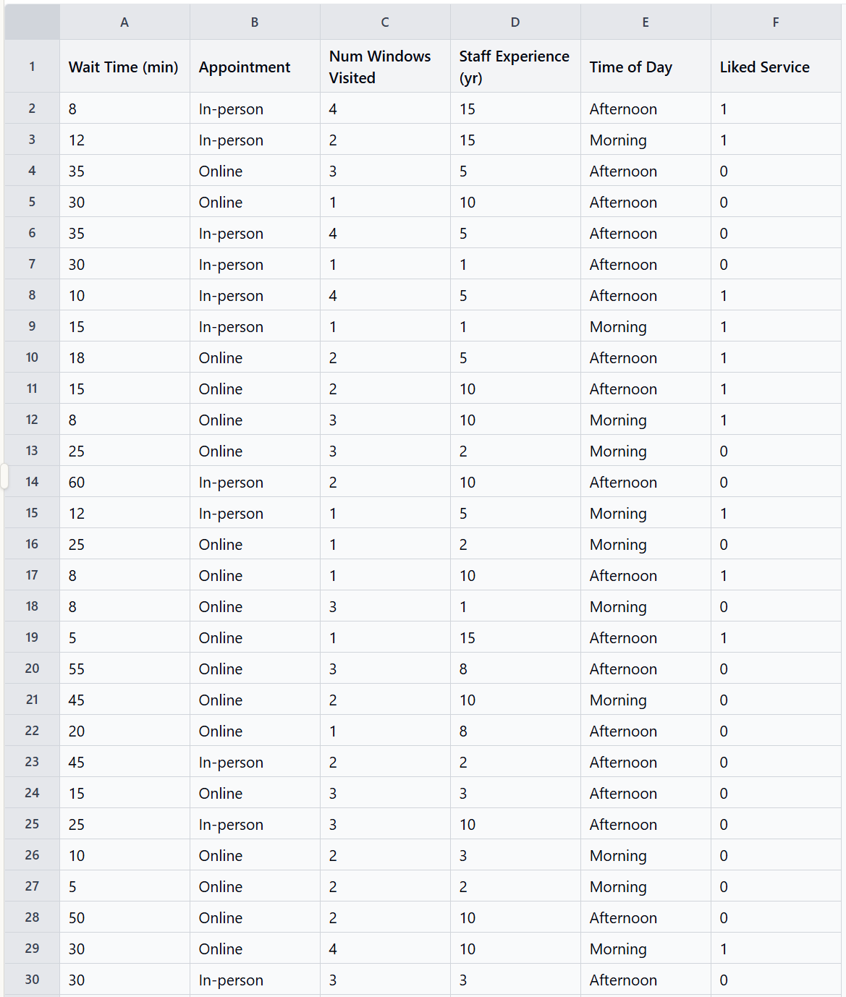
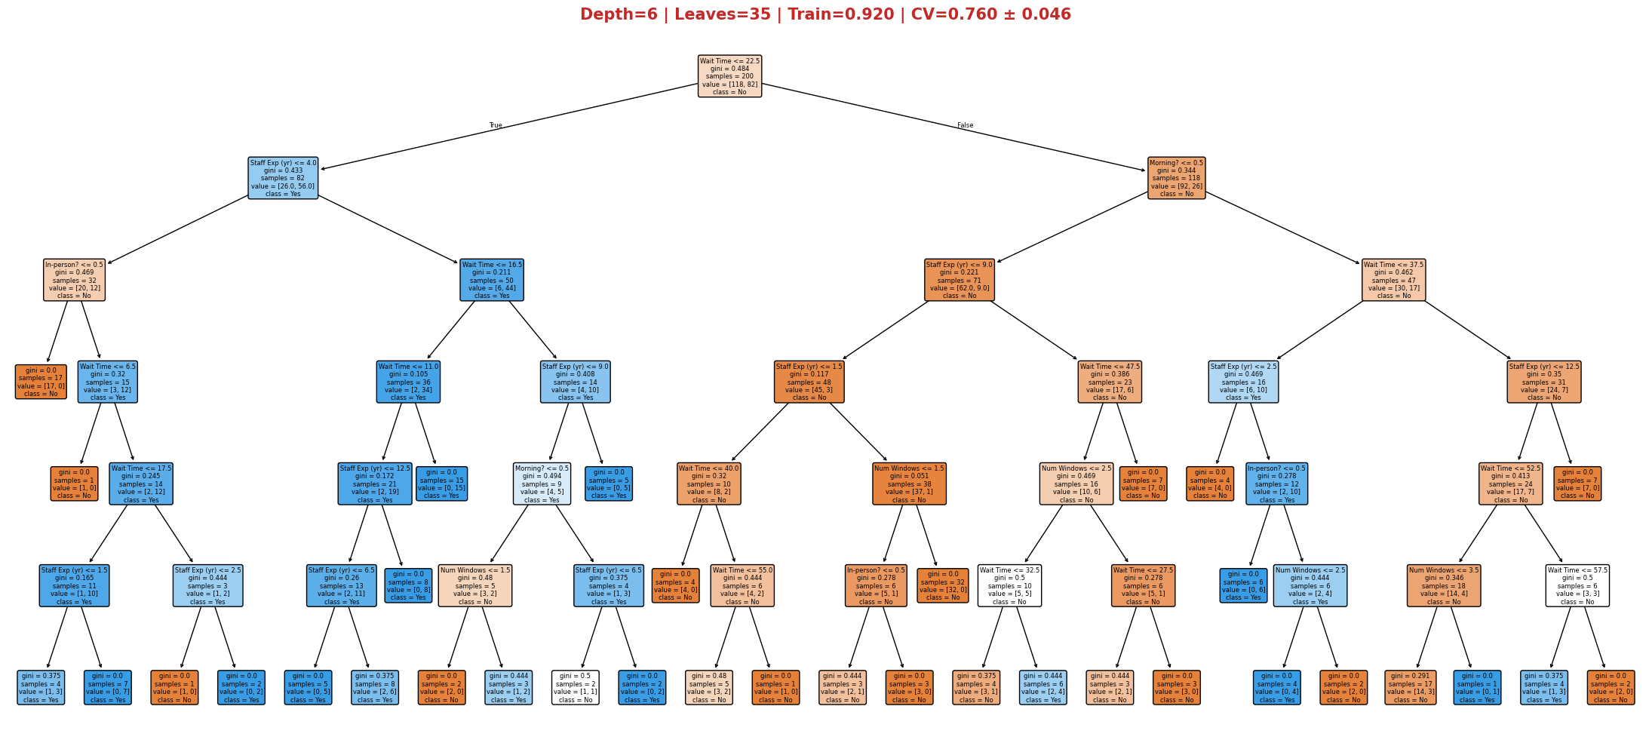
Regularizing trees
Extended dataset. 100 rows and 5 features.

Slide 28

Tree pruning
Extended dataset. 100 rows and 5 features.
$$R_{α}\left(T\right)=R\left(T\right)+α⋅\left|T\right|$$
R(T) = misclassification rate (or Gini) of the tree
∣T∣ = number of leaves
α = penalty per leaf (Hyperparameter)
 | R(T) | Leaves | α | Cost R_α(T)
Before pruning | 0.10 | 32 | 0.02
After pruning | 0.12 | 28 | 0.02

Slide 29
Regularizing while building
max_depth — maximum tree depth. Main overfitting control.
min_samples_split — minimum samples required to split a node.
min_samples_leaf — minimum samples in a leaf node. Prevents leaves like our 1Y 1N case.
criterion — gini or entropy. Gini is faster to compute.
class_weight — handles imbalanced classes. Setting to balanced gives higher weight to the minority class so the tree doesn't just predict the majority everywhere.
Notes:
Some implementation details:
1) Trees are recursive
2) Cython backend
3) Tie-breaking — when classes are tied, sklearn picks the lower-indexed class.

Slide 30
Regularizing while building
While building the trees, you can decide criteria for splitting, how deep, how wide you want them to be
Let’s see it in action

Slide 31
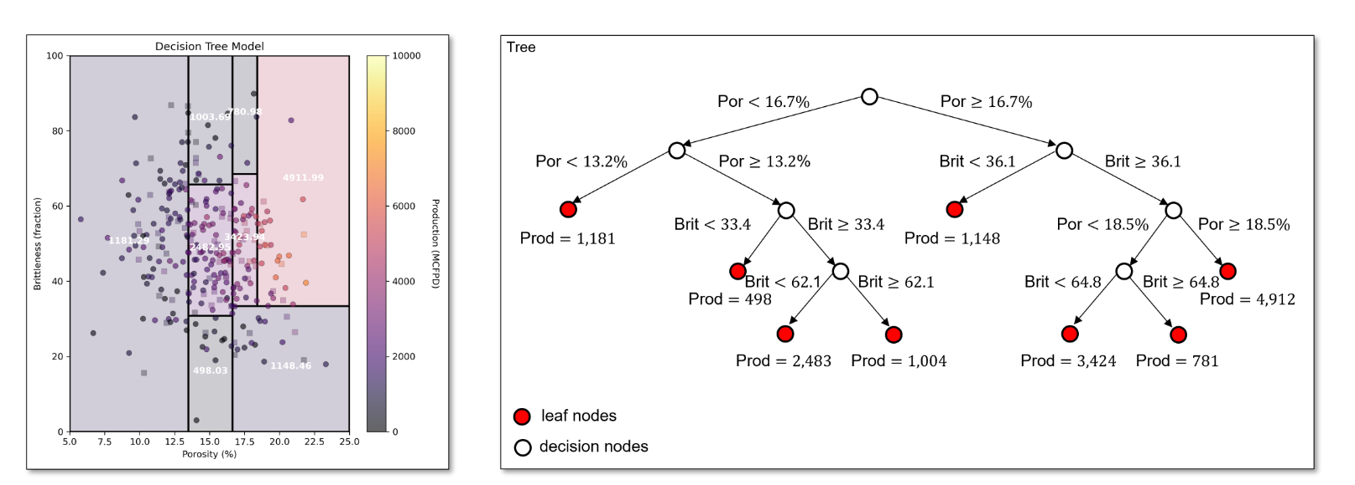
Regression with trees
We discussed classification tasks. But, trees are also widely used in regression. Let’s quickly review!
http://geostatsguy.github.io/MachineLearningDemos_Book/MachineLearning_decision_tree.html#training-the-tree-model

Slide 32



Bagging (Bootstrap)
Trees are prone to overfitting. If you have one expert tree, it may overfit to noise in data
Why not using multiple trees?
Test set
Training set
Weak learner 1
Aggregation
Training
Prediction
Subset 1
Liked
Training
Prediction
Subset 2
Liked
Decision
.
.
.
Liked
Training
Prediction
Subset n
Not liked
Weak learner n
Notes:
Another tree (trained on a different bootstrap sample) overfits to different noise. Average them → the noise cancels, the real signal remains.

Slide 33
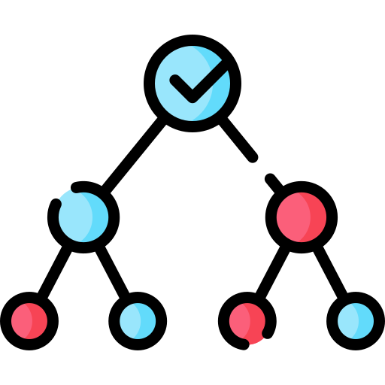
Random Forests
Wait time: < 30
7 samples, 4Y 3N
Bagging is cool, however, imagine our situation:
Since “Wait time” is strong predictor of target variable, regardless of the data fraction we use for constructing trees, most trees will be similar.
Let’s add one more layer of randomness:
Yes
No
Appointment: In person?
5 samples, 4Y 1N
0Y 2N
Samples [4,8,10,28,56]
Features: [Wait time, Staff experience]
Samples [5,2,20,18,26]
Features: [Visited windows, appointment]
Tree 1
Tree 2
New parameter alert: max_features, int, float or {“sqrt”, “log2”}, default=None

Slide 34
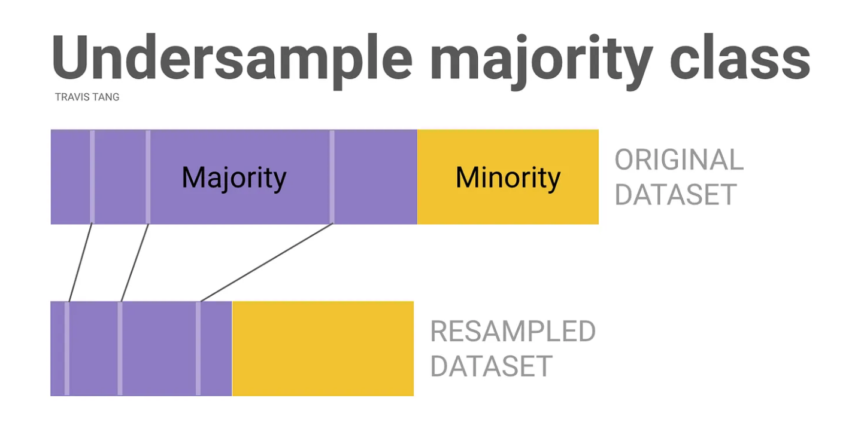

References and further reading
Gradient Boosting:
https://geostatsguy.github.io/MachineLearningDemos_Book/MachineLearning_gradient_boosting.html
Imbalanced Datasets:
https://medium.com/data-science/class-imbalance-strategies-a-visual-guide-with-code-8bc8fae71e1a
Classification metrics:
https://medium.com/@mlmind/evaluation-metrics-for-classification-fc770511052d

Slide 35
















Derivation of gradient descent for logistic regression
1st term
2nd term

